Slide 1
DTW 2026 – Ask Us About ODA Canvas
How to automate deployment and full lifecycle management
of ODA Components
Dr Lester Thomas
Head of New Technologies and Innovation, Vodafone Digital & IT

Slide 2
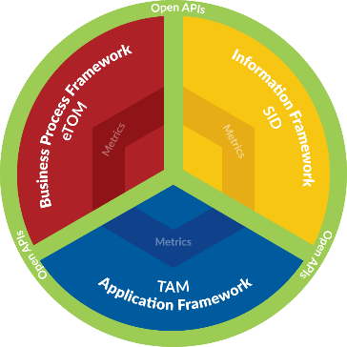
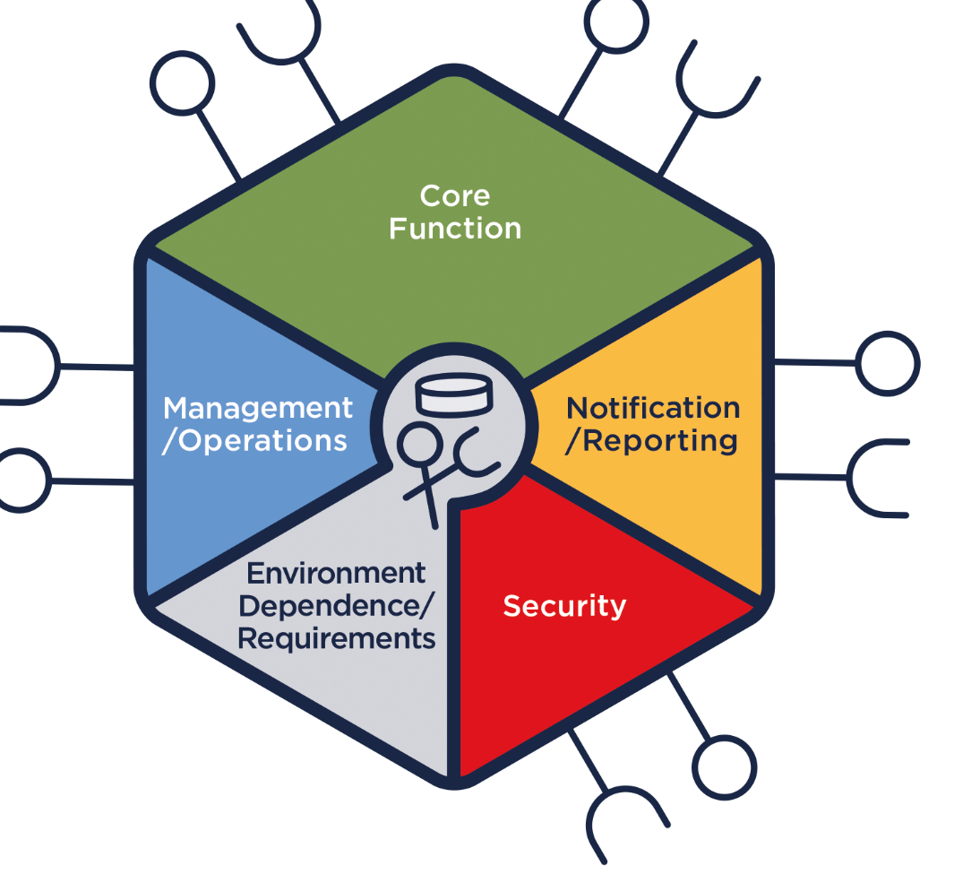
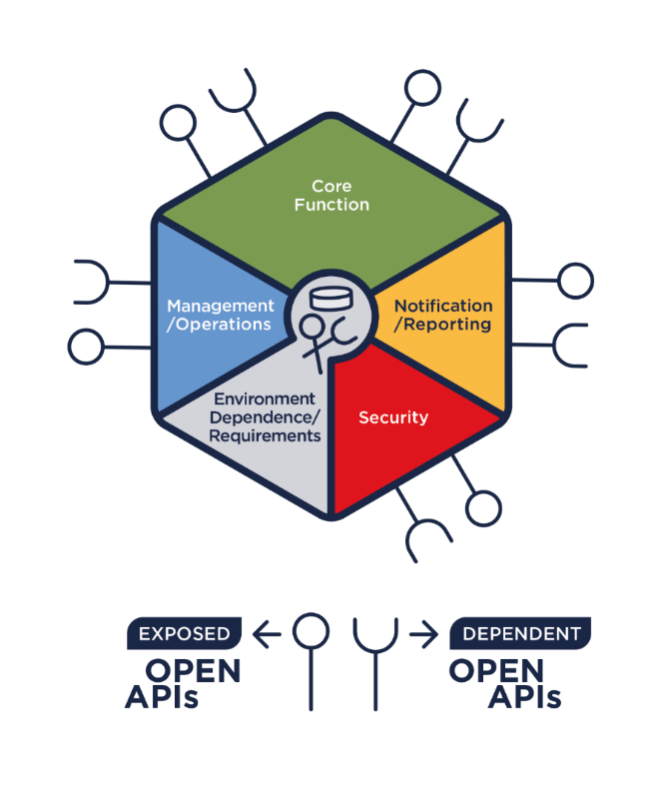
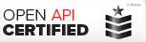
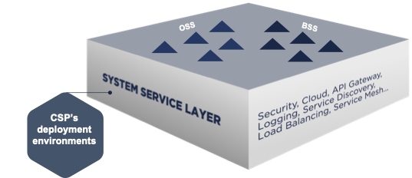
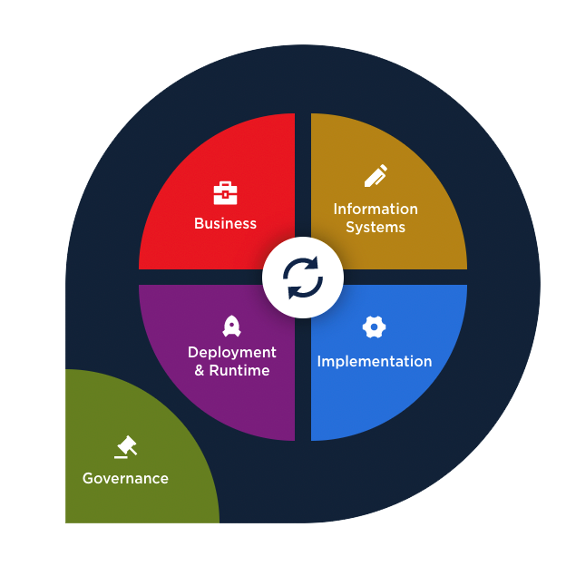

TM Forum ODA: Driving Digital Transformation for over 25 years
Common language and framework
Evolving for 20 years
A common language and framework to support building solutions and simplifying inter-operation between application
(eTOM, SID & Functional Framework (incl. TAM))
ODA provides an evolutionary path…
Open APIs
Components
Open APIs since 2013
ODA Components
A set of REST based Open APIs, with a common data model, to enable system integration.
Standardized, reusable software-defined components connected via Open APIs, to enable cloud native plug and play IT and Networks
ODA Canvas
AI Native ODA Canvas and Components
AI Native ODA
Canvas
Establishing a declarative, standardized blueprint to expose modular, secure, and interoperable interfaces for managing AI-native applications within the ODA Canvas.
The ODA canvas is a software-defined blueprint for a cloud-native operating environment providing an execution environment for ODA components.
ODA
…to drive growth for AI Native Telco
Notes:
We have over 25 Years of active collaboration with TM Forum. The early standards were for Architects and business analysts to use to drive architecture roadmaps, interact with vendors through RFPs and deliver solutions.
These set the common language that everyone in the Telco industry uses
The Open-APIs set out to take this collaboration to a new level, creating machine-readable standards that reduce the friction for integration. The OpenAPIs have been incredibly successful with over 820,000 downloads, over 46,000 developers and more than 2700 organizations.
The open APIs removed the friction for integrating Telco software, it didn’t address the challenges of managing and operating in a cloud-native environment. The ODA Components and Canvas set-out to go one stage further, to agree the modular architecture for independently-deployable software components that are managed and operated in a common way.

Slide 3
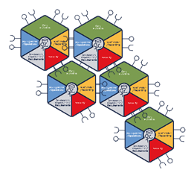
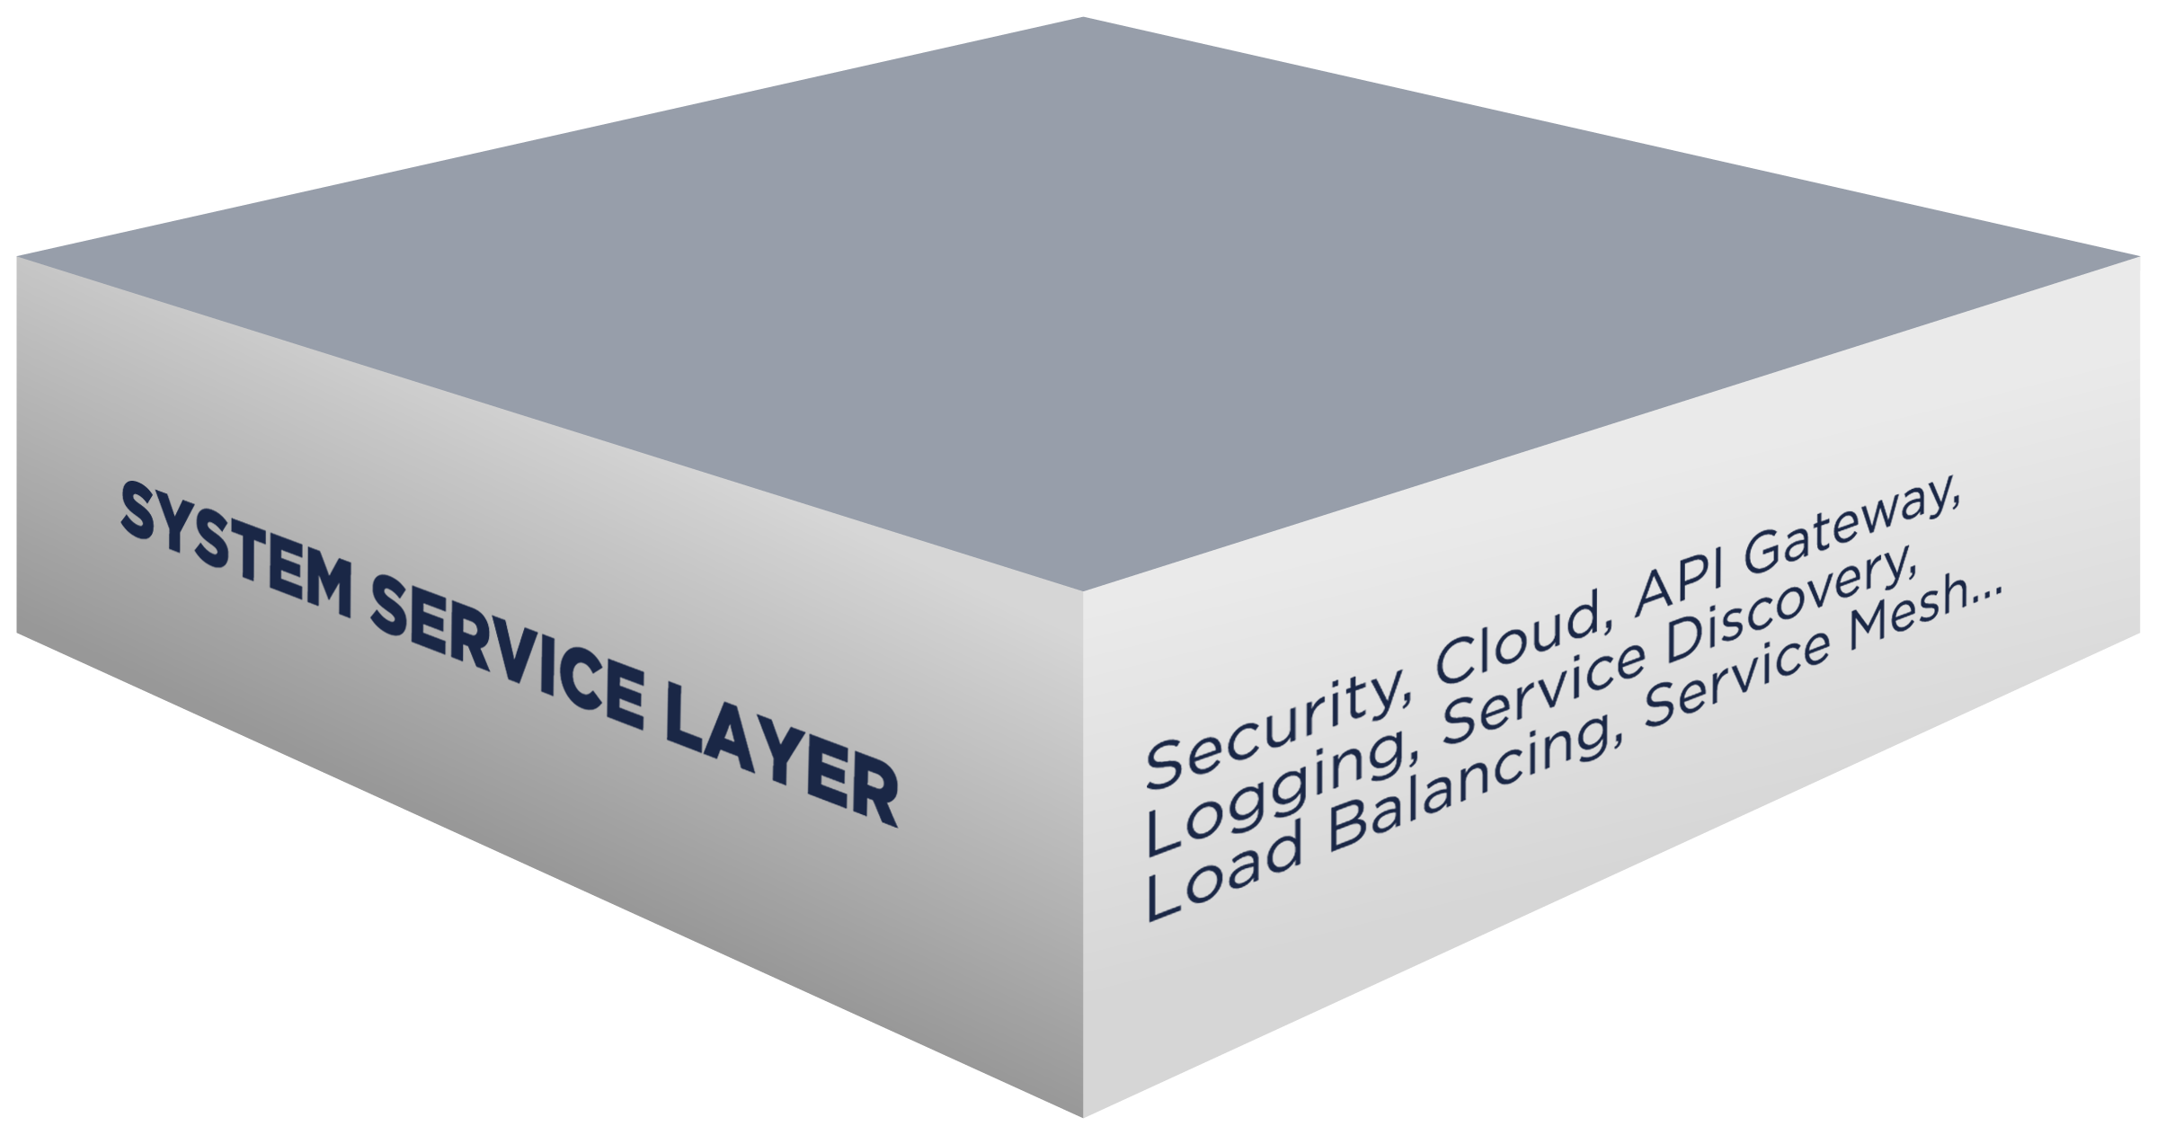
ODA Canvas – Benefits
10x efficiency and agility improvements
Accelerate transformation to AI Native Telco
Customer Experience through seamless integration and “Zero touch, Zero wait and Zero trouble” operations.
Operational Efficiency and Agility through automation. Integration of telco software moves from a manual project to full automation.
Simplicity - from hundreds of operations teams managing vertically integrated applications to a single SRE team.
Security - core architecture implements Zero Trust. Reduced variance and greater collaboration on risk management.
ODA Canvas
Innovation through agility and accelerated adoption of new technology opportunities (e.g. AI-Native) driving industry growth.
Technical Debt - Continuous upgrade of software systems through decoupled and modular interface contracts
https://www.tmforum.org/oda/directory
Notes:
What business problems does the canvas address?
How canvas will move us from an RFP to a POC?

Slide 4
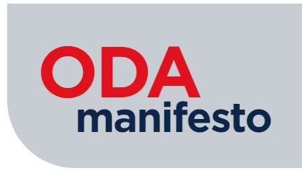
A set of Open Digital Architecture Golden Rules – design principles for the design of modular, reusable technology capabilities;
A common taxonomy and definition of Open Digital Architecture Components – the boundaries, capabilities and ‘minimum viable’ functional and non-functional capabilities and APIs required;
A standardized execution environment for ODA Components (the ODA Canvas), with an open source reference implementation, to simplify the lifecycle management of software and the execution of core business processes;
Open Digital Architecture reference implementations and Conformance Test Kits to enable zero-touch interoperability between ODA Components from different suppliers.
The 1st Goal is for modular, independently deployable, self-descriptive software components.
The 2nd Goal is for a single infrastructure fabric built around open standards, but also including key non-functional services like Security, API Gateway, Service Mesh, Observability, AI Management.
Notes:
Open Digital Architecture Manifesto – TM Forum
OpenAPI Directory
Component Directory
A future vision for the software market that the telecom industry needs to survive and thrive – TM Forum

Slide 5
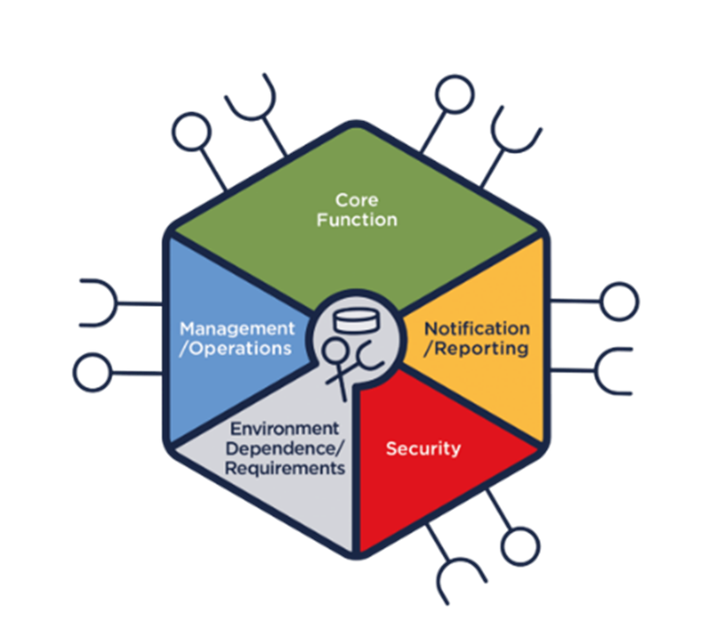
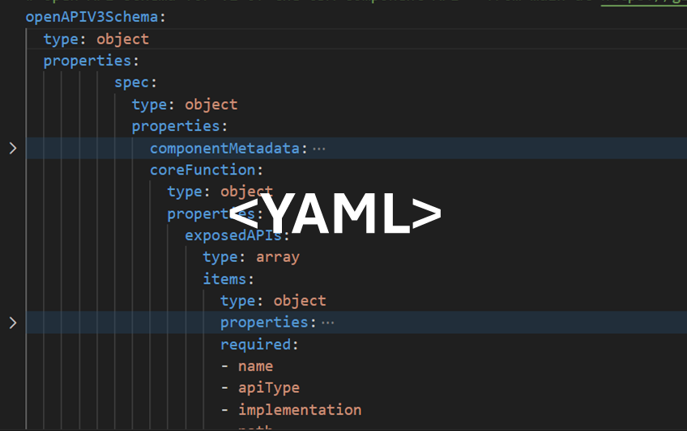
ODA Component YAML definition
Software-defined component. Think ‘swagger’ for a component defining the functional scope, information scope, open-APIs and deployment configuration.

Slide 6
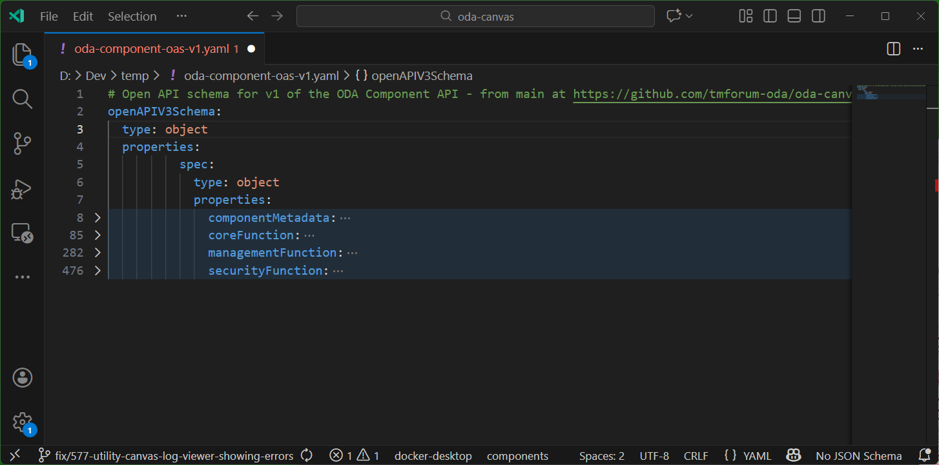
ODA Component YAML definition
Component YAML is an open API v3 schema definition.

Slide 7
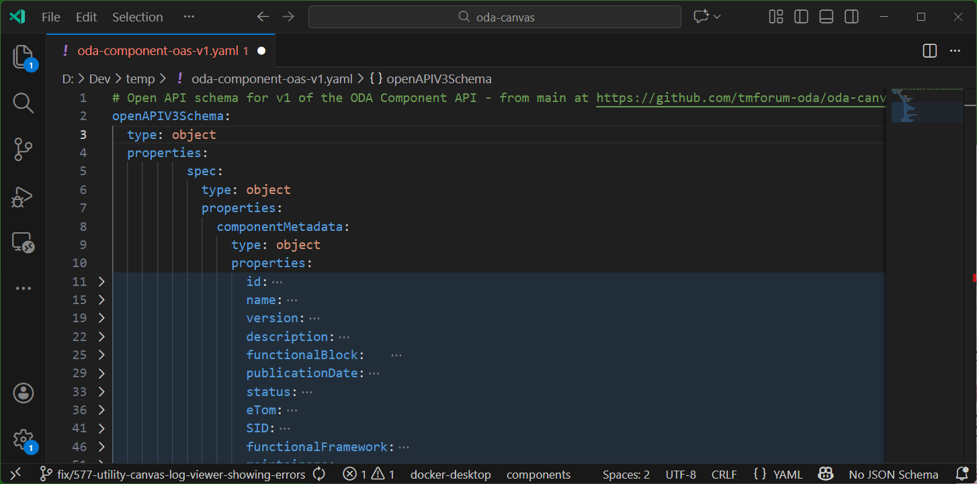
ODA Component YAML definition
Metadata classifies and provides context for the component.

Slide 8
ODA Component YAML definition

Slide 9
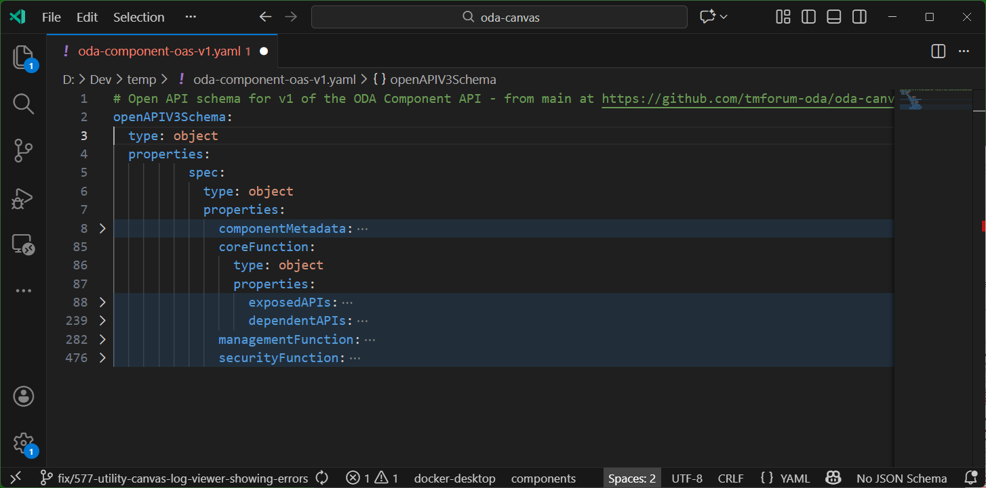
ODA Component YAML definition
CoreFunction describes the functional integration requirements for the Component.

Slide 10
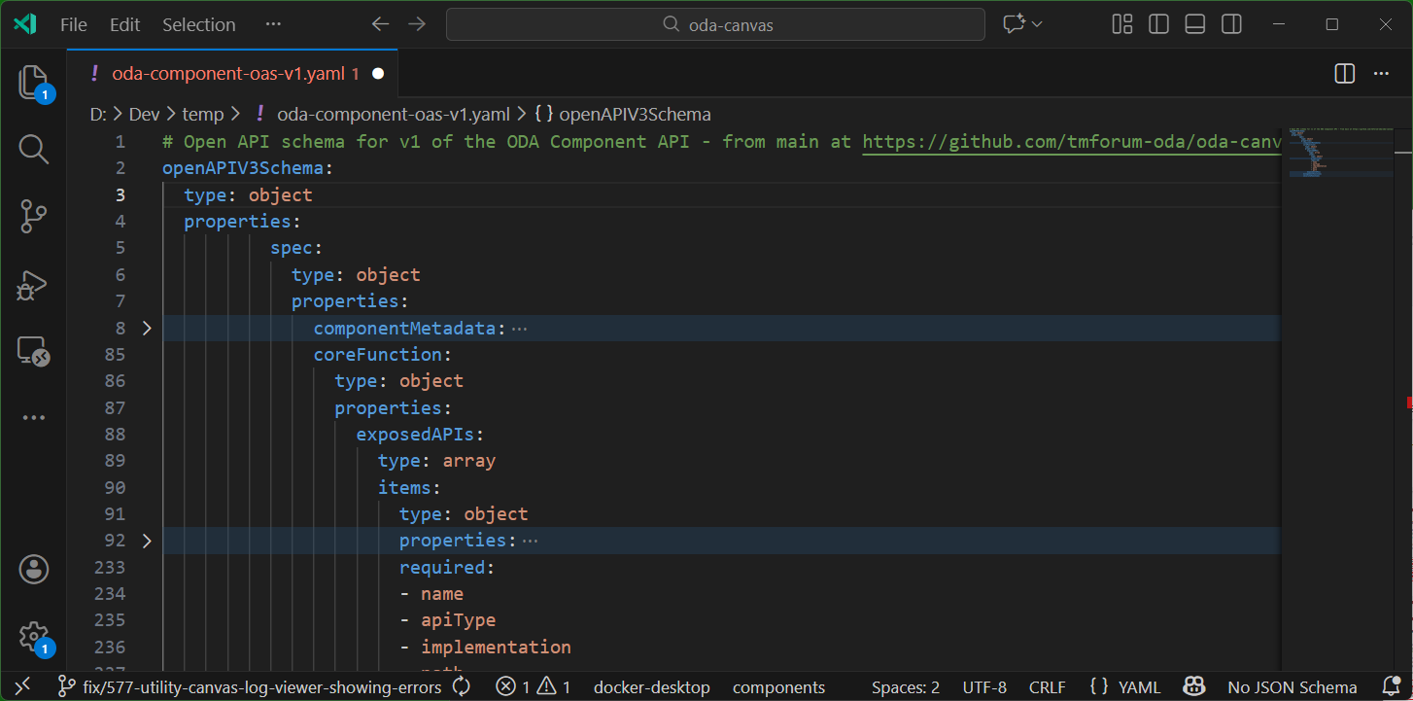
ODA Component YAML definition
ExposedAPIs is a list of APIs the component wants to expose externally.

Slide 11
ODA Component YAML definition

Slide 12
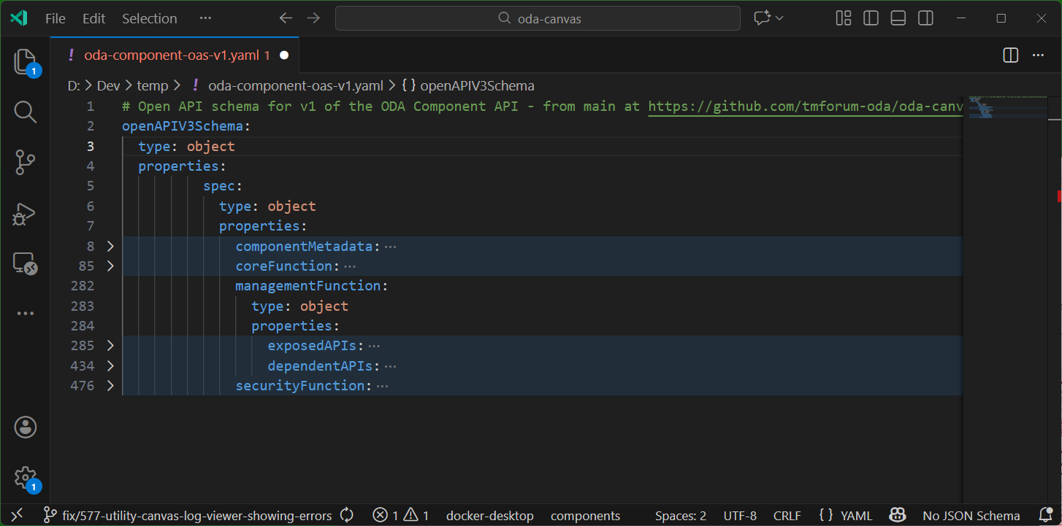
ODA Component YAML definition
ManagementFunction describes non-functional integration requirements.

Slide 13
ODA Component YAML definition

Slide 14
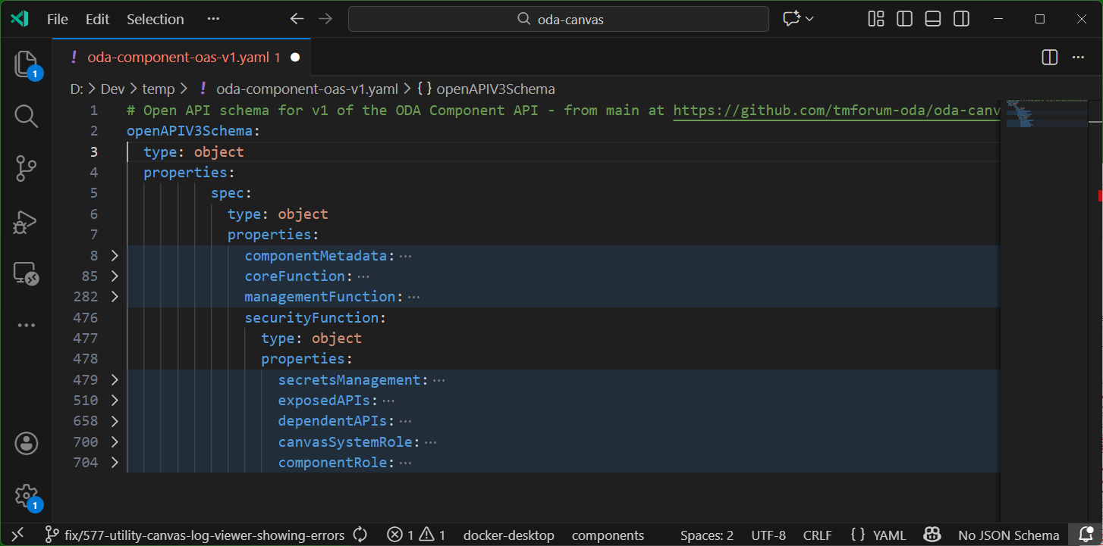
ODA Component YAML definition
SecurityFunction describes requirements for secrets, roles and integration

Slide 15




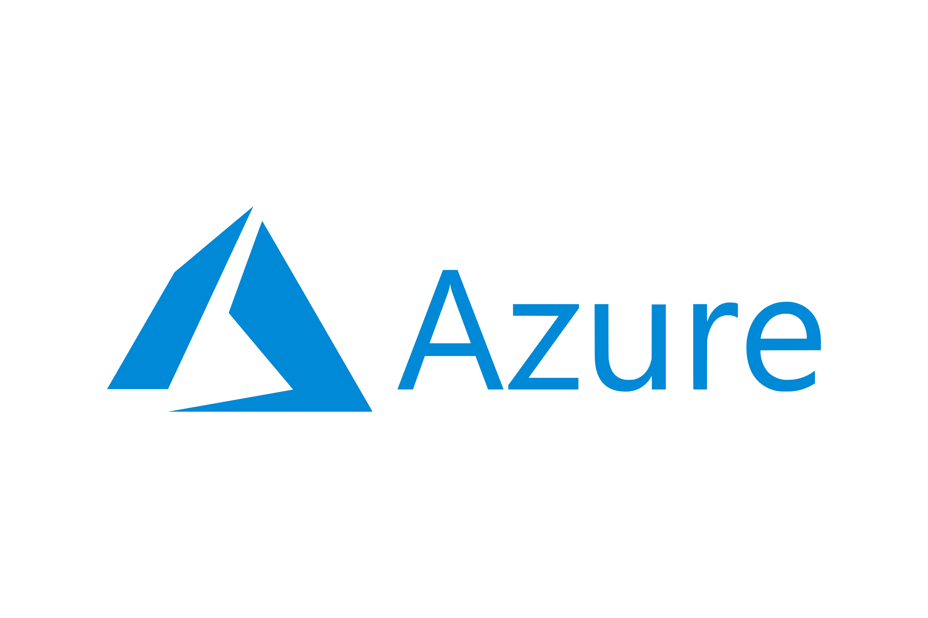
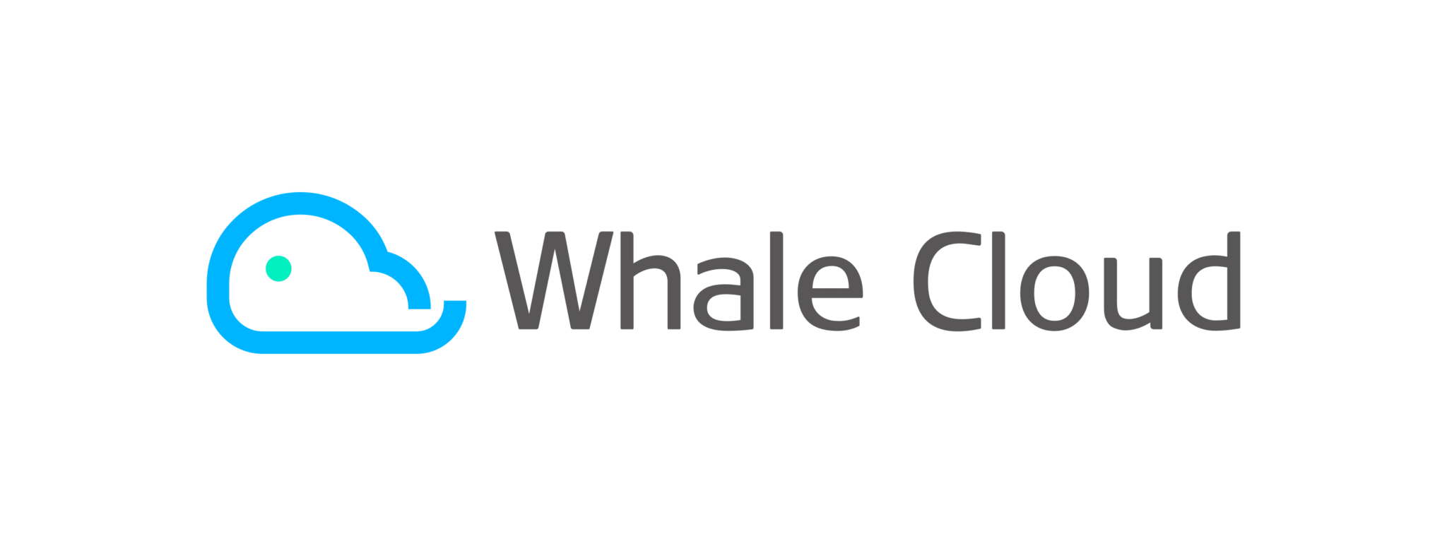
Canvas as a set of Modular Software Operators
The Canvas provides a set of modular operators to automate deployment and lifecycle management of an ODA Component. Each operator processes a sub-set of the overall Component YAML
Kong Gateway
Canvas Modular Operators
Apache APISIX
YAML
API Management
ExposedAPI
Observability Management
Istio Service Mesh
YAML
DependentAPI
Event Management
YAML
Identity Management
Configure and manage underlying System
Google Apigee
YAML
IdentityConfig
Component
Component Management
Secrets Management
YAML
Microsoft Azure API Management
SecretsMgmt
Carbon Management
YAML
Cost Management
AIMgmt
AI Management
WhaleCloud APIG
YAML
Other ….
TBD…

Slide 16
Canvas as a set of Modular Software Operators – API Exposure
The Canvas can be technically implemented on a range of underlying technologies. For example, the refefence implementation has 6 different API Operator, and you could potentially develop an operator for any API Gateway or Service Mesh.
Kong Gateway
Canvas Modular Operators
Apache APISIX
YAML
API Management
ExposedAPI
Observability Management
Istio Service Mesh
YAML
DependentAPI
Event Management
YAML
Identity Management
Google Apigee
Component Management
IdentityConfig
Secrets Management
YAML
Microsoft Azure API Management
SecretsMgmt
Carbon Management
YAML
Cost Management
AIMgmt
AI Management
WhaleCloud APIG
YAML
Other ….
TBD…

Slide 17
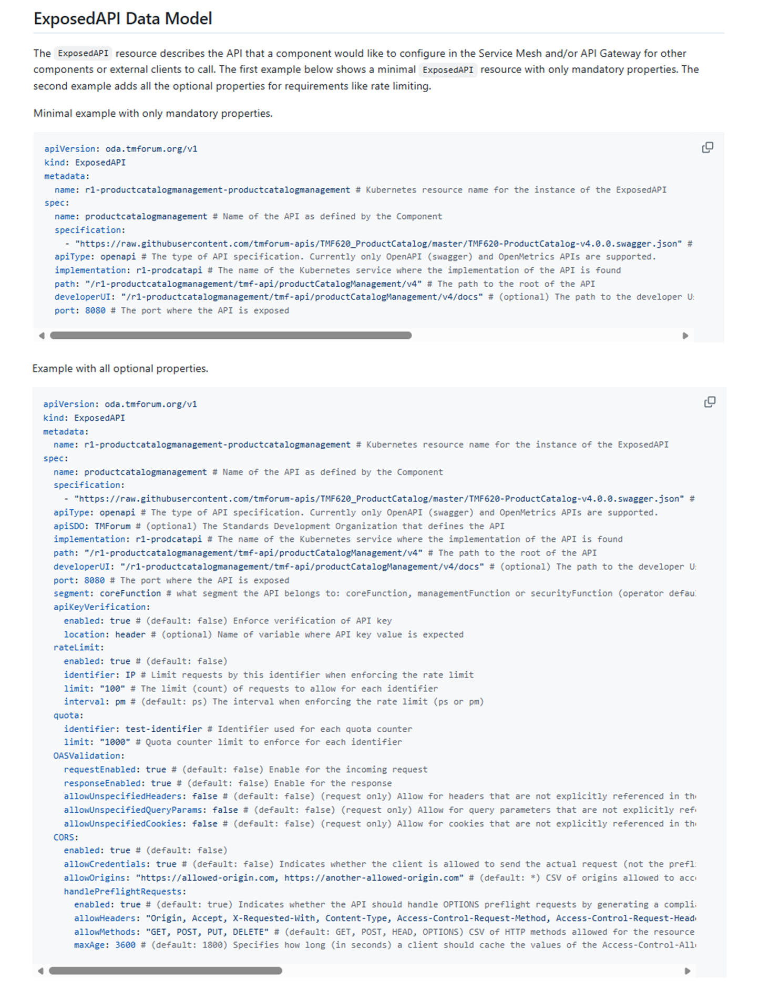
API Exposure deep-dive
ExposedAPI part of YAML spec defines requirements for API Exposure
YAML
Kong Gateway
ExposedAPI
/operators/api-management

Slide 18
API Exposure deep-dive
ExposedAPI part of YAML spec defines requirements for API Exposure
YAML
Kong Gateway
ExposedAPI
/operators/api-management

Slide 19
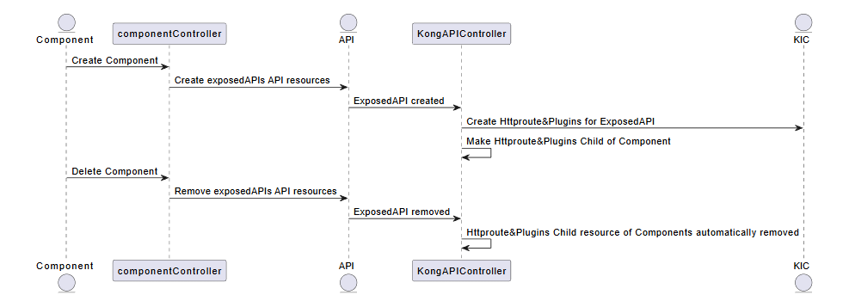
API Exposure deep-dive
ExposedAPI part of YAML spec defines requirements for API Exposure
YAML
Kong Gateway
ExposedAPI
/operators/api-management/kong

Slide 20
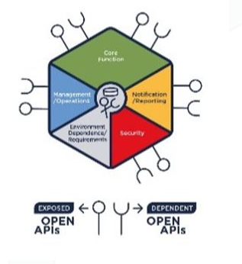

Identity Config Management
Each ODA Component includes a declarative definition of its requirements for Roles and Permissions. The component does not implement any Identity Management solution, but instead relies on an Identity Service to be available in the Canvas.
A Canvas platform can use any Identity Management solution that can support the Oauth 2.0 standard services. Identity Config Operators automate the configuration of the Identity Management Systems using roles and permissions that are mastered in the Component.
Reference canvas now has Identity Config Operators for
Keycloak
Microsoft Azure Entra ID

Slide 21
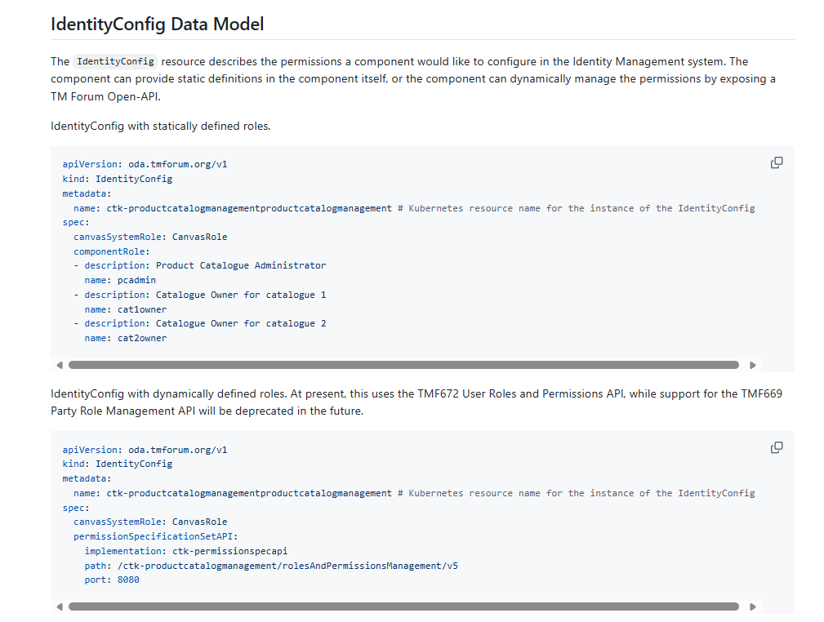
Identity Config Management – Deep Dive
IdentityConfig part of YAML spec defines requirements for Roles
YAML
Keycloak
IdentityConfig

Slide 22
Identity Config Management – Deep Dive
IdentityConfig part of YAML spec defines requirements for Roles
YAML
IdentityConfig

Slide 23

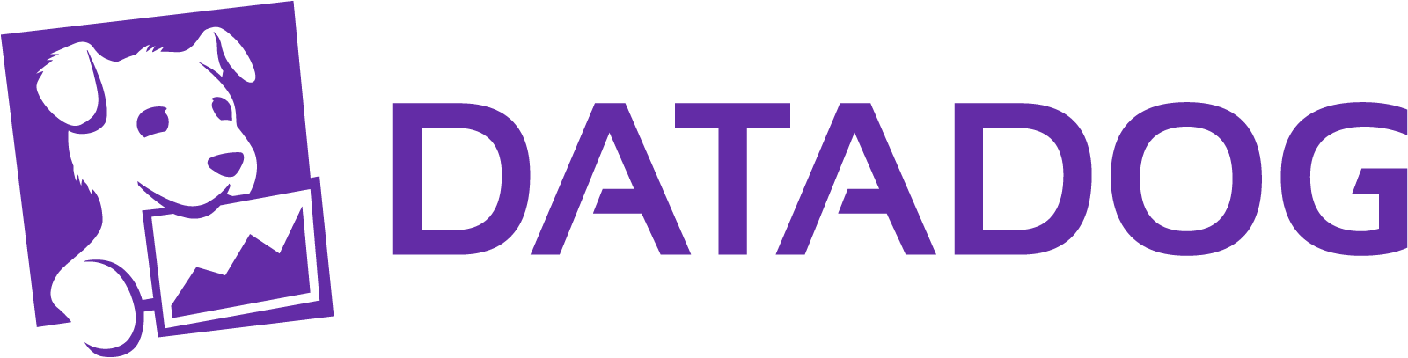
Observability Config Management
Each ODA Component includes a declarative definition of its requirements for Observability. The component does not implement any Observability solution, but instead relies on an Observability to be available in the Canvas.
A Canvas platform can use any Observability solution that can support the Open Metrics and open Telemetry standard services. Observability Config Operators automate the configuration of the Observability Systems using requirements declared in the Component.
Reference canvas now has Observability Operators for
Prometheus / Grafana / Kiali
Microsoft Azure Managed Observability
Google Managed Observability
DataDog

Slide 24
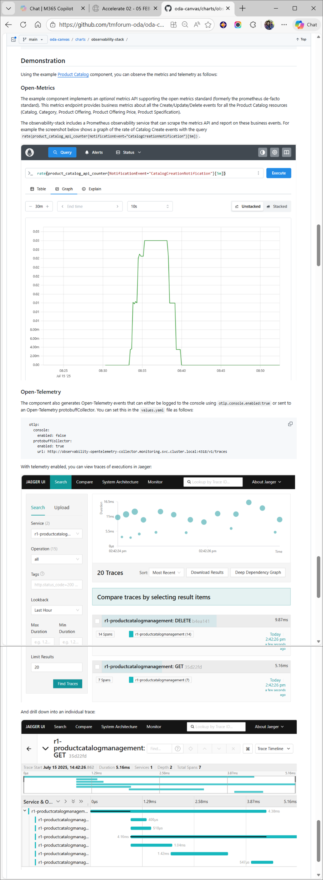
Observability Config Management
OpenMetrics and OpenTelemetry support enable performance monitoring and tracing based on observability data
YAML
Prometheus / Grafana /Jaeger / Kiali
ExposedAPI

Slide 25
Observability Config Management
OpenMetrics and OpenTelemetry support enable performance monitoring and tracing based on observability data
YAML
Prometheus / Grafana /Jaeger / Kiali
ExposedAPI

Slide 26
Observability Config Management
OpenMetrics and OpenTelemetry support enable performance monitoring and tracing based on observability data
YAML
Prometheus / Grafana /Jaeger / Kiali
ExposedAPI

Slide 27
Observability Config Management
OpenMetrics and OpenTelemetry support enable performance monitoring and tracing based on observability data
YAML
Prometheus / Grafana /Jaeger / Kiali
ExposedAPI

Slide 28
How do you measure Canvas adoption?
The goal is to measure the outcome ‘automated Component deployment & lifecycle management’.
A CSP could turn the light green on a number of outcomes
CSP Deployment & lifecycle management automation
future automations ...
API Gateway Automation
Observability Automation
Identity Automation
ResponsibleAI Automation
Cost Management Automation
Carbon Management Automation
Secrets Management Automation

Slide 29

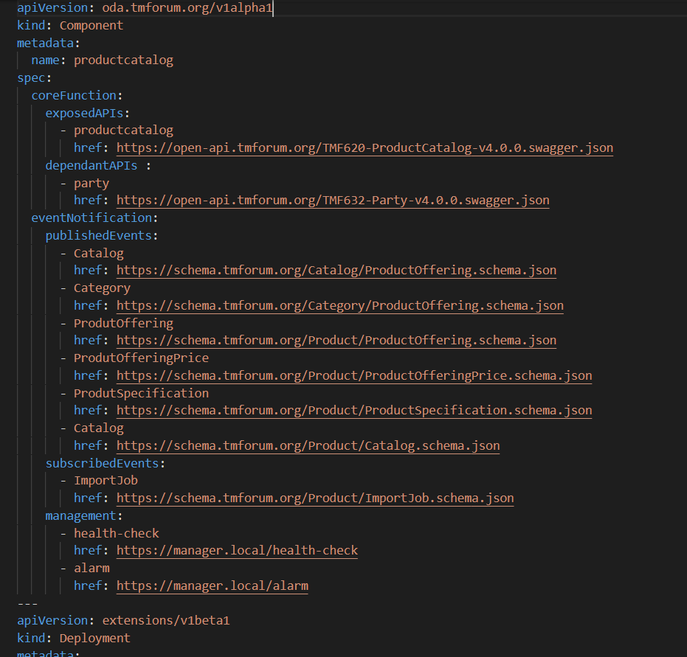
Reference Implementation of Canvas in Kubernetes
K8s implements an Intent-based API.
K8s API
Operators take the intent and orchestrate the underlying infrastructure. E.g. deploy Pod
Infrastructure
Intent
Operator
etcd
Pod
Intent is stored in etcd data-store

Slide 30
Reference Implementation of Canvas in Kubernetes
Some operators only interact with API. e.g. ReplicaSet controller takes a ReplicaSet input and creates Pod intents
K8s API
Operator
Infrastructure
Intent
Operator
Pod
Pod
etcd
Pod

Slide 31
Reference Implementation of Canvas in Kubernetes
Some operators manage external services. e.g. Ingress controller typically manages load balancers running outside Kubernetes.
Load Balancer
Operator
K8s API
Operator
Infrastructure
Intent
Operator
Pod
Pod
etcd
Pod

Slide 32
Multiple components deployed in single Kubernetes canvas
Single operational execution environment for efficiency
Cloud infrastructure and other Non-functional services are configured from ODA Component YAML
Components can discover dependent services
Single Security architecture
Operator
Load Balancer
API Gateway
Event Hub
Operator
K8s API
Operator
Infrastructure
Component A
Pod
Operator
Pod
Pod
Component B
Pod
Pod
Pod
Component C
Pod
Pod
Pod
etcd

Slide 33
Proxy pattern
Proxy pattern allows for components that are not deployed in this K8s environment (e.g. for SaaS or non-containerised workloads).
Operator
Load Balancer
API Gateway
Event Hub
Operator
K8s API
Operator
Infrastructure
Proxy to D
Pod
Component A
Pod
Operator
Pod
Pod
Component B
Pod
Pod
Pod
Component C
Pod
Pod
Pod
etcd
SaaS implementation

Slide 34
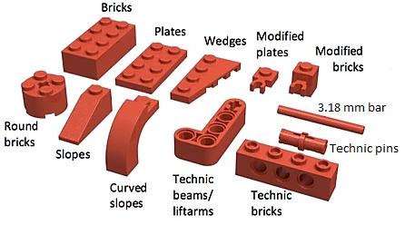
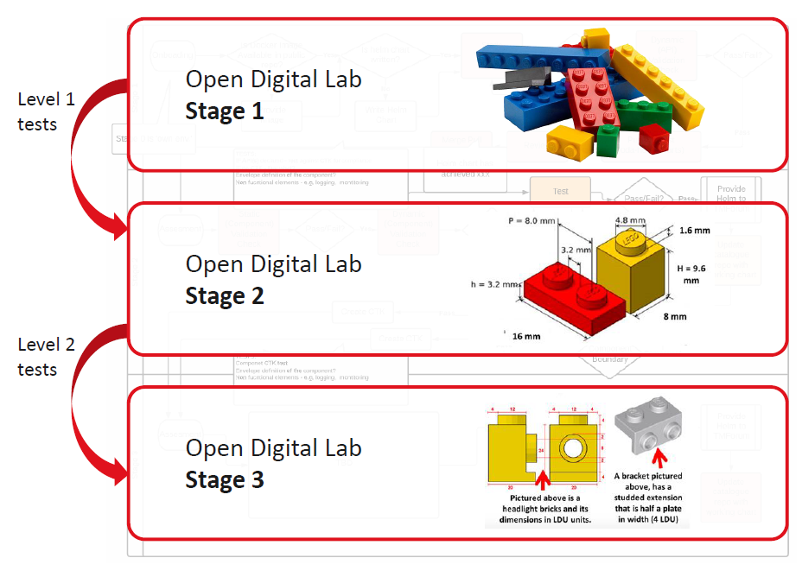
Component Standard in two layers | Lego Analogy
Standard ‘golden’ components representing industry best-practice for decomposing Telco IT into modular building-blocks. Components available in TM Forum - ODA Component Directory
Underlying design patterns and standards for a self-describing, modular software component with security-as-code and management-as-code

Slide 35
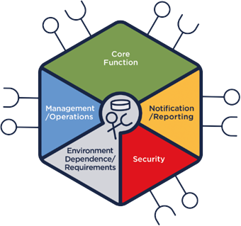
Composable IT with ODA
Use Cases
Order-to-fulfilment
Fault Management
Spatial Web
Satcom with an Edge…
Member case studies
…
IG1228 use case library & AN High Value Scenarios… | Catalyst projects | Real-world references
ODA Components
Open APIs
Vendor members’ commercial products
ODA Canvas
Component Management
API Management
Observability Management
Identity & Credentials
Cost Management
Carbon Management
Canvas Operators developed by the Innovation Hub Canvas project simplify IT Operations
IT Foundations & Platform Services
API Gateway
Service Mesh
Observability
Identity & Access
…
…
Opensource reference modules
Commercial modules from MSFT, GCP…

Slide 36
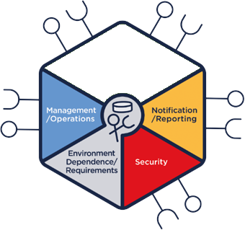
Composable AI with ‘Agentic ODA’
Use Cases
AI Native Blueprint Projects
Formalizing and standardizing the Agentic AI architecture within the ODA framework
The AI Native Canvas is built on the patterns developed by the AI Native Blueprint
Interaction Security Operator workstream
Model Operator workstream
Data Operator workstream
+ Enhancements to SID, eTOM, business architecture, TcOD, governance…
Order-to-fulfilment
Fault Management
Spatial Web
Satcom with an Edge…
Member case studies
…
Demo ONE∞
Fault Resolution
CIT&E and AN
High Value Scenarios
IG1228 use case library & AN High Value Scenarios… | Catalyst projects | Real-world references
DTW26 “Super Catalyst”
ODA Components Agentic Components
Open APIs
MCP
A2A
Open APIs
Vendor members’ commercial products
YAML specifications, instantiated on ODA Canvas
ODA Canvas → AI Native Canvas
Component Management
API Management
Observability Management
Identity & Credentials
Cost Management
Carbon Management
Interaction Security
Model Operator
Data Operator
Canvas Operators developed by the Innovation Hub Canvas project simplify IT Operations
New Canvas Operators for AI & Data services simplify AIOps
IT Foundations & Platform Services
AI & Data Foundations
API Gateway
Service Mesh
Observability
Identity & Access
…
…
AI Gateway
LLMs
Data Products
…
Opensource reference modules
Commercial modules from MSFT, GCP…
Agent lifecycle mgt, guardrail enforcement, orchestration
Reference build by Project ONE∞ Sandbox(es)

Slide 37
Backup

Slide 38
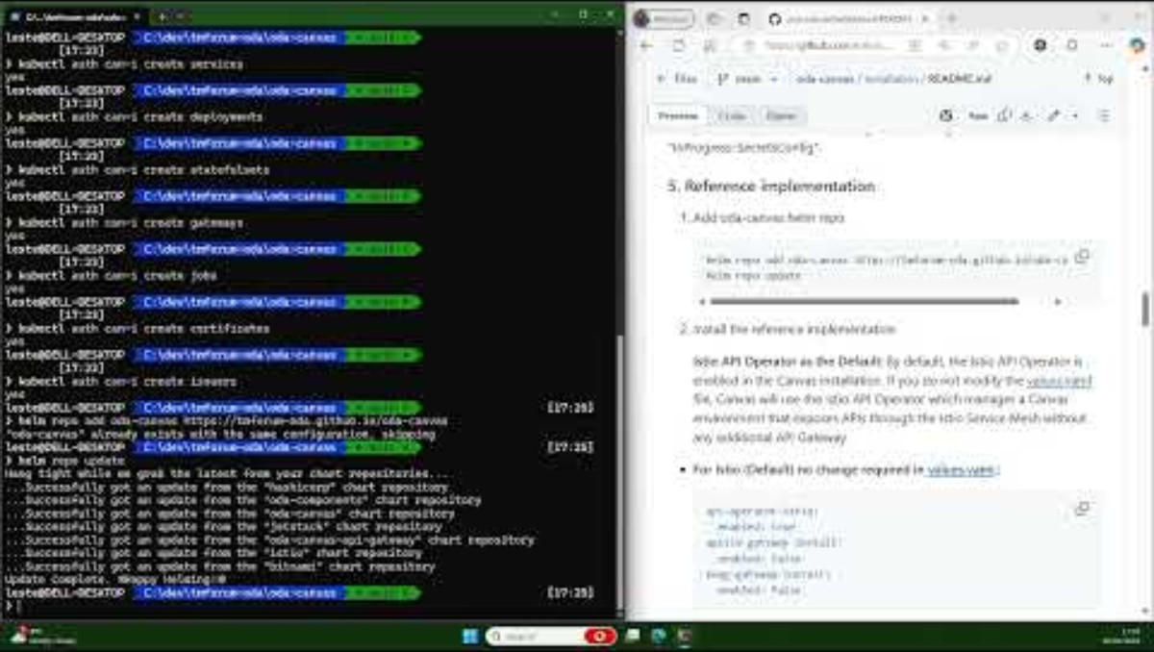
Canvas Installation

Slide 39
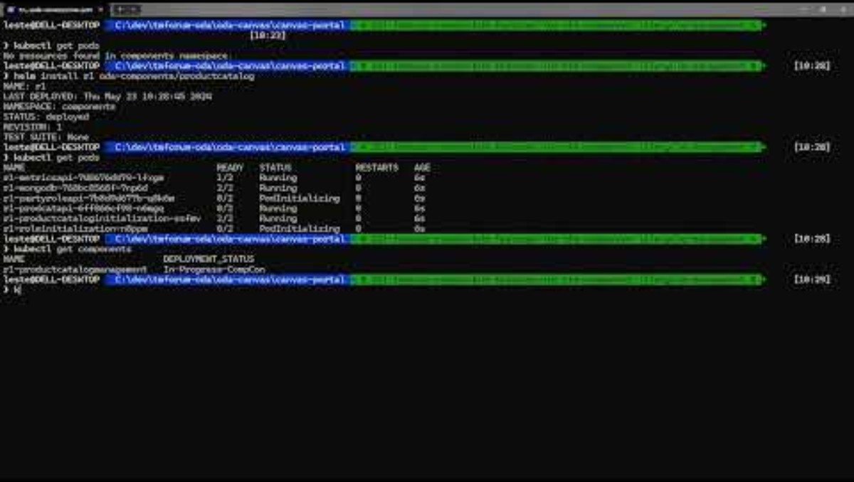
Canvas Portal and tools

Slide 40
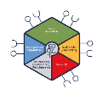
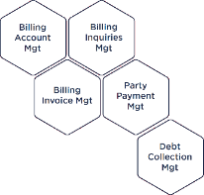

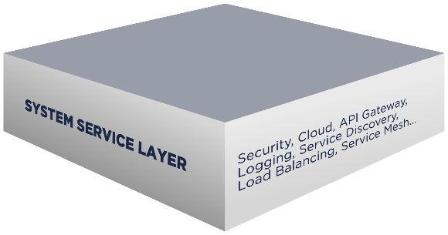

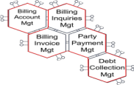
ODA Canvas Collaboration – Software Operators
The ODA Canvas ensures that software following the ODA Component standard is portable across multiple platforms. It reduces the toil required to deploy and operate software by automating the standard services that are required by all software components.
It provides a reference implementation of all the standard Canvas Operators. As of May 2025, the operators are listed below. The list of operators are extensible, based on contributions from participants.
Canvas Operators
Component Management
Secrets Management
API Management
Carbon Management
OSS
BSS
Observability Management
Cost Management
Event Management
AI Management
Identity Management
Other ….
ODA Canvas

Slide 41



API Management
Each ODA Component includes a declarative definition of its requirements for exposing its APIs. The APIs can be for the core function of the component, or for managing and securing the component itself.
A Canvas platform can use any API Gateway and/or Service Mesh to expose these APIs in a secure and controlled way. API Operators automate the configuration of the API Gateways and Services Meshes.
Reference canvas now has API Operators for
Apache APISIX
Kong Gateway
Istio Service Mesh
Microsoft Azure API Management
Google Apigee
WhaleCloud APIG

Slide 42
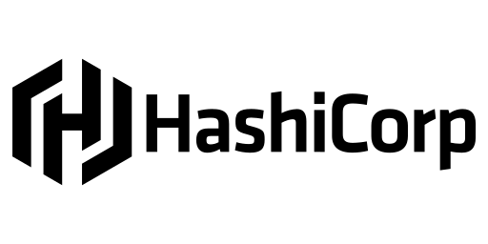
Identity Config Management
Each ODA Component includes a declarative definition of its requirements for Roles and Permissions. The component does not implement any Identity Management solution, but instead relies on an Identity Service to be available in the Canvas.
A Canvas platform can use any Identity Management solution that can support the Oauth 2.0 standard services. Identity Config Operators automate the configuration of the Identity Management Systems using roles and permissions that are mastered in the Component.
Reference canvas now has Identity Config Operators for
Keycloak
Microsoft Azure Entra ID
New

Slide 43
Observability Config Management
Each ODA Component includes a declarative definition of its requirements for Observability. The component does not implement any Observability solution, but instead relies on an Observability to be available in the Canvas.
A Canvas platform can use any Observability solution that can support the Open Metrics and open Telemetry standard services. Observability Config Operators automate the configuration of the Observability Systems using requirements declared in the Component.
Reference canvas now has Observability Operators for
Prometheus / Grafana / Kiali
Microsoft Azure Managed Observability
New
Google Managed Observability
DataDog

Slide 44
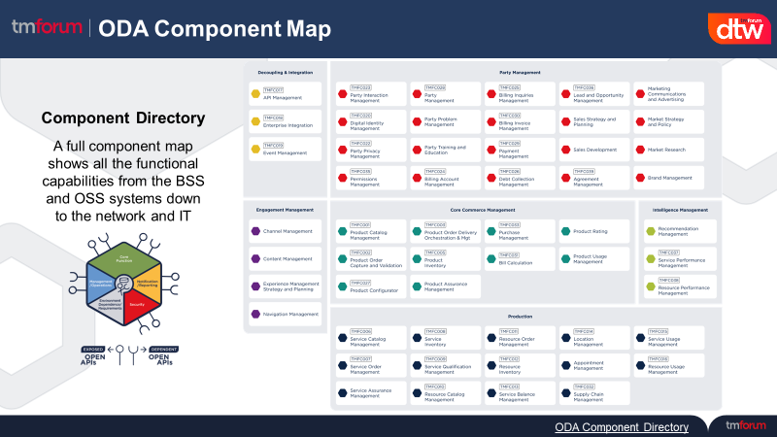
Components and Canvas – A Story in Two Parts
What is an ODA Component?
What is the ODA Canvas?
Vendor with ODA compliant components
Canvas Operators
OSS
Component Management
API Management
Observability Management
ODA Canvas
Event Management
Identity Management
Secrets Management
Carbon Management
Cost Management
AI Management
Other ….
Components enable solutions to be built easily and quickly from a set of plug and play “Lego blocks”.
Connected using Open APIs and based on a standard data model.
Delivering agility, flexibility and scalability. Strengthening and simplifying the procurement process.
This is made possible by an operational Canvas, exposing standard services for monitoring, management, security, etc.
Delivering simplified operations and reducing total cost of ownership.
https://www.tmforum.org/oda/directory
Notes:
What business problems does the canvas address?
How canvas will move us from an RFP to a POC?

Slide 45
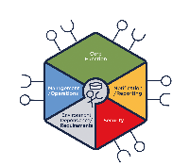
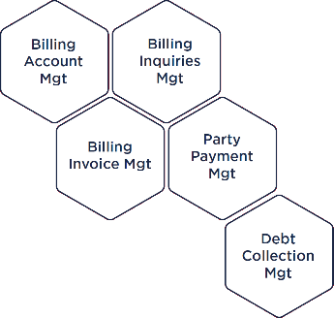
How do I buy or build a canvas?
Reference Implementation at
github.com/tmforum-oda/oda-canvas
Multiple public cloud offerings
OSS
BSS
'Roll your own' based on the Reference Implementation
Infrastructure software vendors offering operators/managers for their software
Published as Apache 2.0 licensed assets including a Canvas Compliance Test Kit (CTK)
Canvas is Modular : You can mix & match these approaches
Notes:
One question that we often get asked Is how do I buy or build a canvas. The reference implementation of the oda canvas is designed to have a set of services that are freely available for organisations to use, extend or to build into their own implementations. All of these capabilities have been built by the community And published as Apache two licenced Assets. We also expect hyperscale public cloud companies to build canvas services on their own native cloud services as well as infrastructure software vendors building operators for their own particular soft applications.
[click]
So the choice for a csp wanting to buy or build their own canvas is to Use one of the multiple public cloud offerings to roll their own based on the reference implementation, or to use canvas services from infrastructure software vendors.
[Click]
This is not an either or decision - You can mix and match these approaches To build your own canvas.
The individual modules of a canvas are called canvas operators and they follow a standard pattern used in many Kubernetes applications.
So what types of canvas operator are available?

Slide 46
What types of Canvas Operator are available?
OSS
Canvas Operators
Component Management
API Management
Observability Management
Event Management
Identity Management
Secrets Management
Carbon Management
Cost Management
AI Management
Other ….
Notes:
There are several types of operator in the ODA Canvas. For each type of operator, there may be multiple technical implementations. The list below shows the types of operator available in the ODA Canvas reference implementation. This list is not exhaustive and we foresee new operator types becoming available as the ODA Canvas matures.
Lets go through a few examples:

Slide 47
What types of Canvas Operator are available?
API Management Operators
OSS
Kong Gateway
Canvas Operators
Component Management
Apache APISIX
API Management
Observability Management
Istio Service Mesh
Event Management
Identity Management
Google Apigee
Secrets Management
Carbon Management
Microsoft Azure API Management
Cost Management
AI Management
WhaleCloud APIG
Other ….
Notes:
The first is API Operators
Each ODA Component includes a declarative definition of its requirements for exposing its APIs. The APIs can be for the core function of the component, or for managing and securing the component itself.
A Canvas platform can use any API Gateway and/or Service Mesh to expose these APIs in a secure and controlled way. API Operators automate the configuration of the API Gateways and Services Meshes.
Reference canvas now has API Operators for

Slide 48
What types of Canvas Operator are available?
OSS
Canvas Operators
Component Management
API Management
Observability Management
Event Management
Identity Management
Secrets Management
Carbon Management
Cost Management
AI Management
Other ….

Slide 49
What types of Canvas Operator are available?
Observability Management Operators
OSS
Canvas Operators
Component Management
Prometheus / Grafana / Kiali
API Management
Observability Management
Google Managed Observability
Event Management
Identity Management
Microsoft Azure Managed Observability
Secrets Management
DataDog
Carbon Management
Cost Management
AI Management
Other ….
Notes:
Similarly, Each ODA Component includes a declarative definition of its requirements for Observability. The component does not implement any Observability solution, but instead relies on an Observability to be available in the Canvas.
A Canvas platform can use any Observability solution that can support the Open Metrics and open Telemetry standard services. Observability Config Operators automate the configuration of the Observability Systems using requirements declared in the Component.
Reference canvas now has Observability Operators for

Slide 50
What types of Canvas Operator are available?
OSS
Canvas Operators
Component Management
API Management
Observability Management
Event Management
Identity Management
Secrets Management
Carbon Management
Cost Management
AI Management
Other ….

Slide 51
What types of Canvas Operator are available?
OSS
Canvas Operators
Component Management
API Management
Identity Config Operators
Observability Management
Event Management
Keycloak
Identity Management
Secrets Management
Microsoft Azure Entra ID
Carbon Management
New
Cost Management
AI Management
Other ….
Notes:
For Identity Management, a key concept with the ODA Components and Canvas model is that each component does not need to implement its own Identity Management solution.
This is a change from the Application architecture we see today where most of our Vendor solutions come with their own identity management solutions – this causes considerable friction for CSPs as we need to integrate this into our company standard IDM solution where we master our Employee system access. The ODA Component and Canvas model simplifies this by getting the components to master only the role and permission information they require to be linked to identities, and enable each component to integrate to the single IDM solution made available in the Canvas.
Each ODA Component includes a declarative definition of its requirements for Roles and Permissions.
A Canvas platform can use any Identity Management solution that can support the Oauth 2.0 standard services. Identity Config Operators automate the configuration of the Identity Management Systems using roles and permissions that are mastered in the Component.
Reference canvas now has Identity Config Operators for

Slide 52
What types of Canvas Operator are available?
OSS
Canvas Operators
Component Management
API Management
Observability Management
Event Management
Identity Management
Secrets Management
AI Management
Carbon Management
Future planned operators
Cost Management
Other ….
Notes:
AI Management Operator
We believe that within a short period of time, most software components will embed AI as part of their core functionality. This could be using custom AI models or accessing Foundation GenAI models. The AI Operator allow components to include a declarative definition of its requirements for AI and GenAI services. The Canvas makes these services discoverable from the underlying Cloud platform.
The goal is to enable all software components to use AI or GenAI services, but have strong control and governance of the AI services being used. The Canvas will include all the required capabilities to control and monitor the use of AI services to ensure we are using AI in a responsible way, aligned with regulatory requirements like the EU AI act.
Carbon Management Operator
Carbon Aware Software refers to applications and systems designed to optimize their energy consumption in order to reduce carbon emissions associated with electricity use.
This is achieved by making the software "aware" of the carbon intensity of the electricity grid—that is, the amount of carbon dioxide emissions produced per unit of electricity consumed at any given time and location.
By leveraging real-time data on grid carbon intensity, carbon aware software can schedule computational tasks, adjust performance settings, or shift workloads to times and places where renewable energy sources are more prevalent, minimizing the overall carbon footprint.
The Carbon Management Operator will provide services to measure and optimize the carbon intensity for ODA Components. It will build on standards and services from Green Software Foundation and build on the services offered from Public Cloud providers.
Cost Management Operator
This operator is proposed to automate cost optimization and license management.
Users of the Cloud Platform: Benefit from automated cost savings, improved financial transparency, and simplified license management, leading to reduced expenses and enhanced operational efficiency.
Vendors of Software Deployed on the Cloud: Gain accurate usage tracking, revenue protection through license compliance, and valuable market insights, enhancing customer satisfaction and informing product strategies.
Cloud Platform Providers: Enjoy increased customer loyalty, optimized resource utilization, and a competitive market advantage by offering value-added services that promote customer success and sustainability.
Database Management Operator
This operator is proposed to automate access to Database-as-a-Service. It allows a component to request access to various types of Database. This should include Relational, Document, Key-Value, Graph and Vector databases

Slide 53
